Slide 1
Introduction to Arduino
Microcontroller prototyping for the Internet of Things
Notes:
It’s an exciting time to be an embedded device engineer. There’s something of a backside to Moore’s law in play here, and while high preformance microchips continue to get faster and smaller; low performance microchips continue to get cheaper and cheaper. At the same time, open source software has delivered tools for programming these devices that are powerful, easy to use, and free. Lastly, vendors like Adafruit, Sparkfun, and even Amazon ensure that finding the components you need for your project is easy and cost effective.

Slide 2
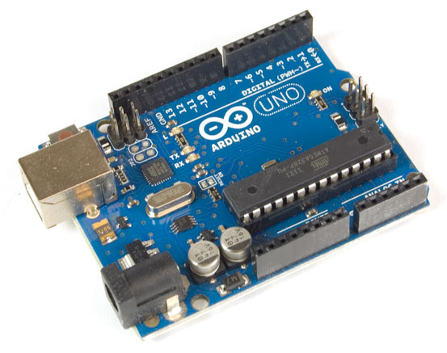
What is an Arduino and what does it do?
?
An Arduino is a small, cheap, simple computer that does whatever you tell it to, and it communicates with other devices to tell them what to do.
BOSS
Notes:
We refer to this class of devices as microcontrollers or MCUs.
It's also worth mentioning that an Arduino can be controlled by another device like a computer, a Raspberry Pi, even another Arduino.
Low level components aren’t like peripherals for consumer devices in that there is very rarely a compatibility issue. They don’t have drivers, you just understand how they work, what pins to what, and you wire and program them accordingly. You don’t have to buy an arduino sensor, you just buy a sensor. Sometimes though, you may want to select a device that someone ELSE has already gotten working for your platform of choice.

Slide 3
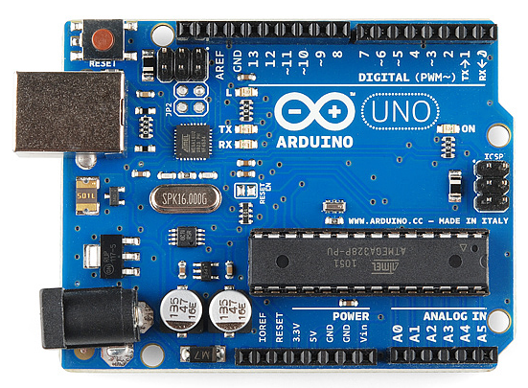
Basic Components of the Arduino
ATMega Processor
Serial Hardware Interface
Analog Input Pins
GPIO Pins
Digital Interface Pins
Power Components
Notes:
In this class we are going to stick to talking about the Arduino Uno R3. There are many other formats of Arduino, since the terms refers to an entire family of AVR processors that are compatible with the Arduino development tools, as well as the myriad breakout boards that house them.

Slide 4
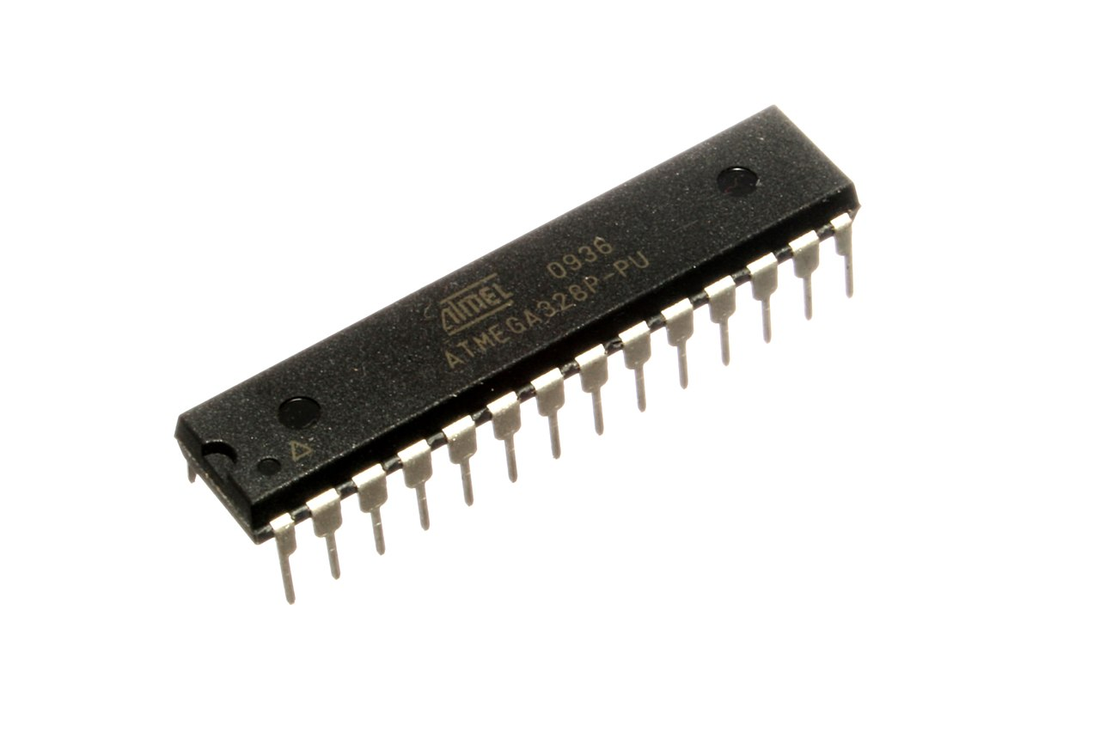
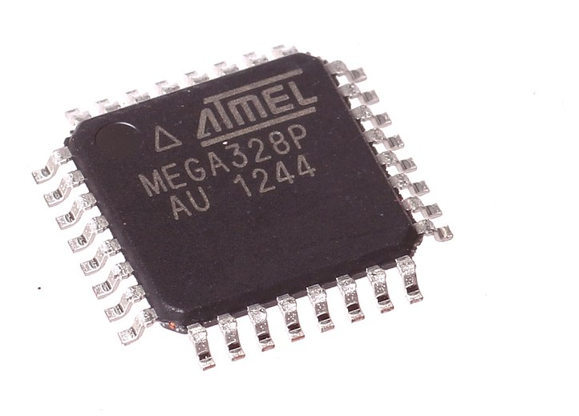
ATMega328 microprocessor
8-bit AVR RISC
20 MHz
32kB of Flash (slow and non volatile)
1kB of EEPROM (non volatile and fast)
2kB of SRAM (fast and volatile)
Notes:
AVR was among the first microchips to use re-programmable flash memory.
RISC = reduced instruction set computer
The ATMega uses 8-bit architecture while most cell phones use 64-bit (~10^16 larger)
The ATMega runs at 20 Mhz while cell phones go from 1.4 - 2.5 Ghz (x100)
The ATMega has around 3kB of RAM while most cell phones have several GB (x 1,000,000)

Slide 5
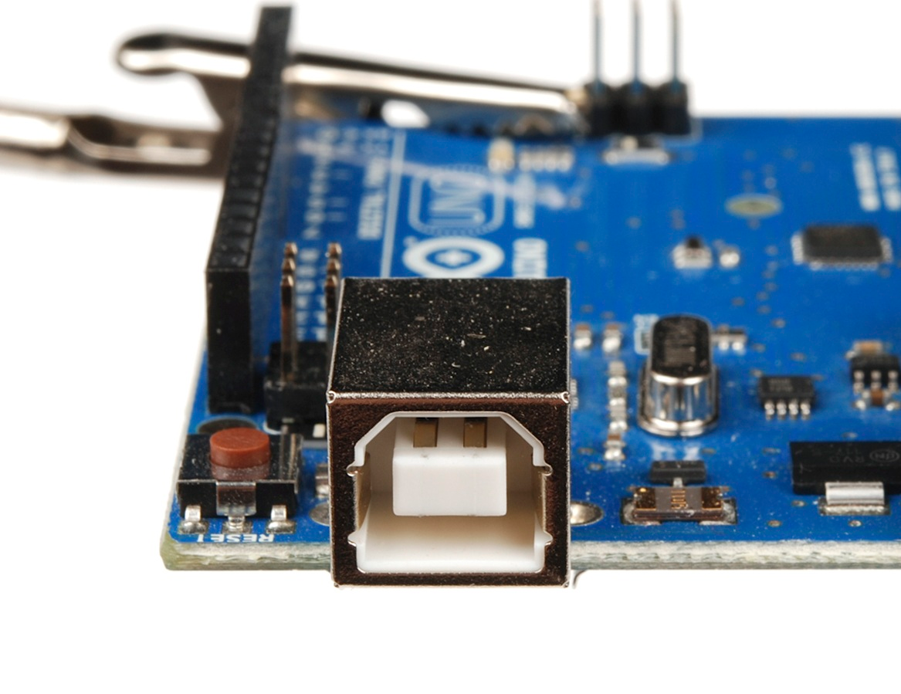
Serial Hardware Interface
Provides USB interface with computer for loading code and debugging
Can also be used to provide power to the Arduino
Can also be used instead for serial communication with other devices
Notes:
This is NOT a USB host controller, so don’t expect to do something like plug in a USB device and have it work.
You can, however, use this serial interface with a computer or even Raspberry Pi to make the device function like a peripheral by sending it commands or having it return values with an interface that you write.

Slide 6
Analog Pins
Connect to analog input devices like sensors
Connected to the on board 10-bit ADC
Turns a DC voltage from 0-5V into a 10-bit number from 0-4096
This number usually represents some physical value like light, temperature, or pressure
Notes:
ADC = Analog to Digital converter
Later we will de-mystify the process by which something physical like temperature becomes something digital like a 10-bit number expressing degrees C.
Analog values are continuous.

Slide 7
GPIO Pins
These pins can be controlled by the Arduino to be either high (5V) or low (0V)
This can be used to drive very simply devices like diodes or transistors directly
This can also be used to read directly from simple devices to determine whether they are high or low.
Unlike the Analog pins, we can’t tell what the voltage is other than on or off
Notes:
GPIO = General Purpose Input/Output
Digital values are discreet

Slide 8
Digital Pins
The GPIO pins are (mostly) dual purpose
They can be used to send a communicate over protocols like I2C and SPI, either by using the hardware on the microchip or even using software serial implementations
Some of these pins are also capable of generating a Pulse Width Modulation (PWM) signal.
Using these digital protocols it just barely outside the scope of this course
Notes:
I2C = Inter-integrated circuit
SPI = Serial peripheral interface
This course was originally designed as a 4 day course. There are lessons on I2C and SPI like the ones you’ll do in this course available on the github page.

Slide 9
Power Components
The Arduino has a barrel jack adapter for powering the system through a battery pack
The Arduino can be powered by batteries ranging from 7V-12V using its voltage regulator.
The Arduino provides power to external devices at 5V and 3.3V
Notes:
The arduino can also be powered through the VIN pin
The arduino provies a VREF pin for the ADC pins
While the Arduino can provide power to your project, it’s very limited in the current it can provide. For more power hungry projects, expect to need an alternative power supply.
The fact that the Arduino can be powered by USB is very useful, since it opens up lots of options for USB battery packs to power the device.
The Arduino can also be powered by a 7-12V barrel jack AC adapter.

